Slide 1
MICRO PROJECT USING PYTHON : CAR SHOWROOM MANAGEMENT
SUBMITTED BY:
DIVYA ROSE RAJU -U1503067
JOEL KURIAN -U1503093
FARHAN E ABDUL SALAM –U1503072
SUBMITTED ON :
13TH NOVEMBER 2015

Slide 2
Car Showroom
Abstract
Objective : To manage a car showroom
Method : The customers are shown a list of cars
available in the showroom , from which
they can select a car of their choice.
Input provided : Name of the car
Expected output : Shows the car and the model of the car
and the available colour.
Working : The customer is asked to enter the car name
and if the car is available,Its details
like cost,model…etc will be displayed .
If the car is not available the customer
is shown the list of cars available .
He can select one. Also there are options
to update stock(adding or deleting of cars).
GROUP MEMBERS : TEACHER-IN-CHARGE :
FARHAN E A S - ATHIRA V PANICKAR
DIVYA ROSE RAJU - ATHIRA V PANICKAR
JOEL KURIAN - VARGHESE S

Slide 3
PROBLEM DEFINATION
The scope of our program is in the field of carshowroom management.The program helps the customers to enquire into the availability of cars and its various features which include car model ,colour , price.....etc.The customers can book their required car.The program has functions to add cars to the showroom’s stock.A Main Menu , which routs us to three options,Enquiry,Carbooking and Exit from the program.
Our program begins by adding cars to the showroom’s database by invoking the djfcars() function.Here we enter the car name and other details,which are stored in memory using dictionary,which is done by the showroom manager.

Slide 4
Now,its the customer interface.The customer has options : 1-Enquiry
2-Car Booking
3-Exit
from which he can choose from.
CASE -1 :
If the customer has choosen option 1.He is asked to enter his required car name .if the car is in stock ,its details including, name,model,colour,price and availability will be displayed and options to enquire details and to go back to main menu are produced before him and he can choose according to his desire.if the car is out of stock,an out of stock message will be displayed and options to enquire into another car details and to go back to main menu will be presented before the customer.Enquiry is done using function enquiry() .
CASE -2 :
If the customer has choosen option 2.He will be directed to function carbooking() .He is asked to enter the required car name .If the specified car is

Slide 5
available, all its details will be displayed. The customer is asked to confirm ,if he wants to proceed to booking or not.If he is to proceed to booking ,the customer details such as name ,phone number,email...etc. Will be extracted from the customer and stored to a text file,file.txt along with the car details.And the customer is automatically directed out of the program.
CASE -3 :
The customer will be directed out of the program, any moment he chooses option 3.

Slide 6
SOURCE CODE
import string import glob import pickle def djfcars(): n=input("enter number of cars to be added:") for i in range(n): name=raw_input("Car Name:") a=[] a.append(raw_input("Model:")) a.append(input("price:")) a.append(raw_input("colour:")) a.append(input("In stock :")) d[name]=a

Slide 7
def mainmenu(): print"\t","\t","MAIN MENU" print print"1-Enquiry" print"2-Car booking" print"3-Exit" x=input("Enter your option :") if x==1 : enquiry() elif x==2 : carbooking() elif x==3 : exit() else : print"Invalid Option" def enquiry() : y=raw_input("Enter car name of your choice :") t=d.has_key(y)

Slide 8
if t==0 : print"Car Unavailable" else: l=[] l=d[y] print"Model :",l[0] print"Price :",l[1] print"colour :",l[2] print"In Stock :",l[3] if l[3]==0 : print"car out of stock" print"Check another car :" print"1-yes" print"2-No" p=input("enter your option :") if p==1 : enquiry() elif p==2 : mainmenu() else : print"Invalid Option"

Slide 9
def carbooking() : y=raw_input("Enter car name of your choice :") t=d.has_key(y) if t==0 : print"Car Unavailable" else: l=[] l=d[y] print"Model :",l[0] print"Price :",l[1] print"colour :",l[2] print"In Stock :",l[3] if l[3]==0 : print"car out of stock" if t==0 or l[3]==0 : print"Available Cars :" print d.keys() y=input("choose a car :") print"Do you want to proceed to booking :" print"1-yes" print"2-No" r=input("enter your option :") if r==2 :

Slide 10
mainmenu() elif r==1 : f1=open("file.txt","w") print"Customer Details :" cname=raw_input("Name :") cadd=raw_input("Address :") cno=input("Mobile number :") cmodel=y cmail=raw_input("E-mail :") adv=input("Advance paid(if any,) :") pickle.dump((cname,cadd,cno,cmodel,cmail,adv),f1) f1.close() l[3]=l[3]-1 print"Succesfully Booked",y print"Thank You"

Slide 11
d={} djfcars() print"\t","\t","MICRO PROJECT USING PYTHON" print"\t","\t","CAR SHOWROOM MANAGEMENT" print"TEAM MEMBERS","\t","\t","REG. NO." print"Divya Rose Raju","\t","U1503067" print"Joel Kurian","\t","\t","U1503093" print"Farhan E Abdul Salam","\t","U1503072" print"CLASS: S1 CSE-BETA" print"Under the guidance of :Ms Athira and Mr Varghese " print print"\t","\t","WELCOME TO DJF CARS WORLD" mainmenu()

Slide 12
SAMPLE OUTPUT

Slide 13
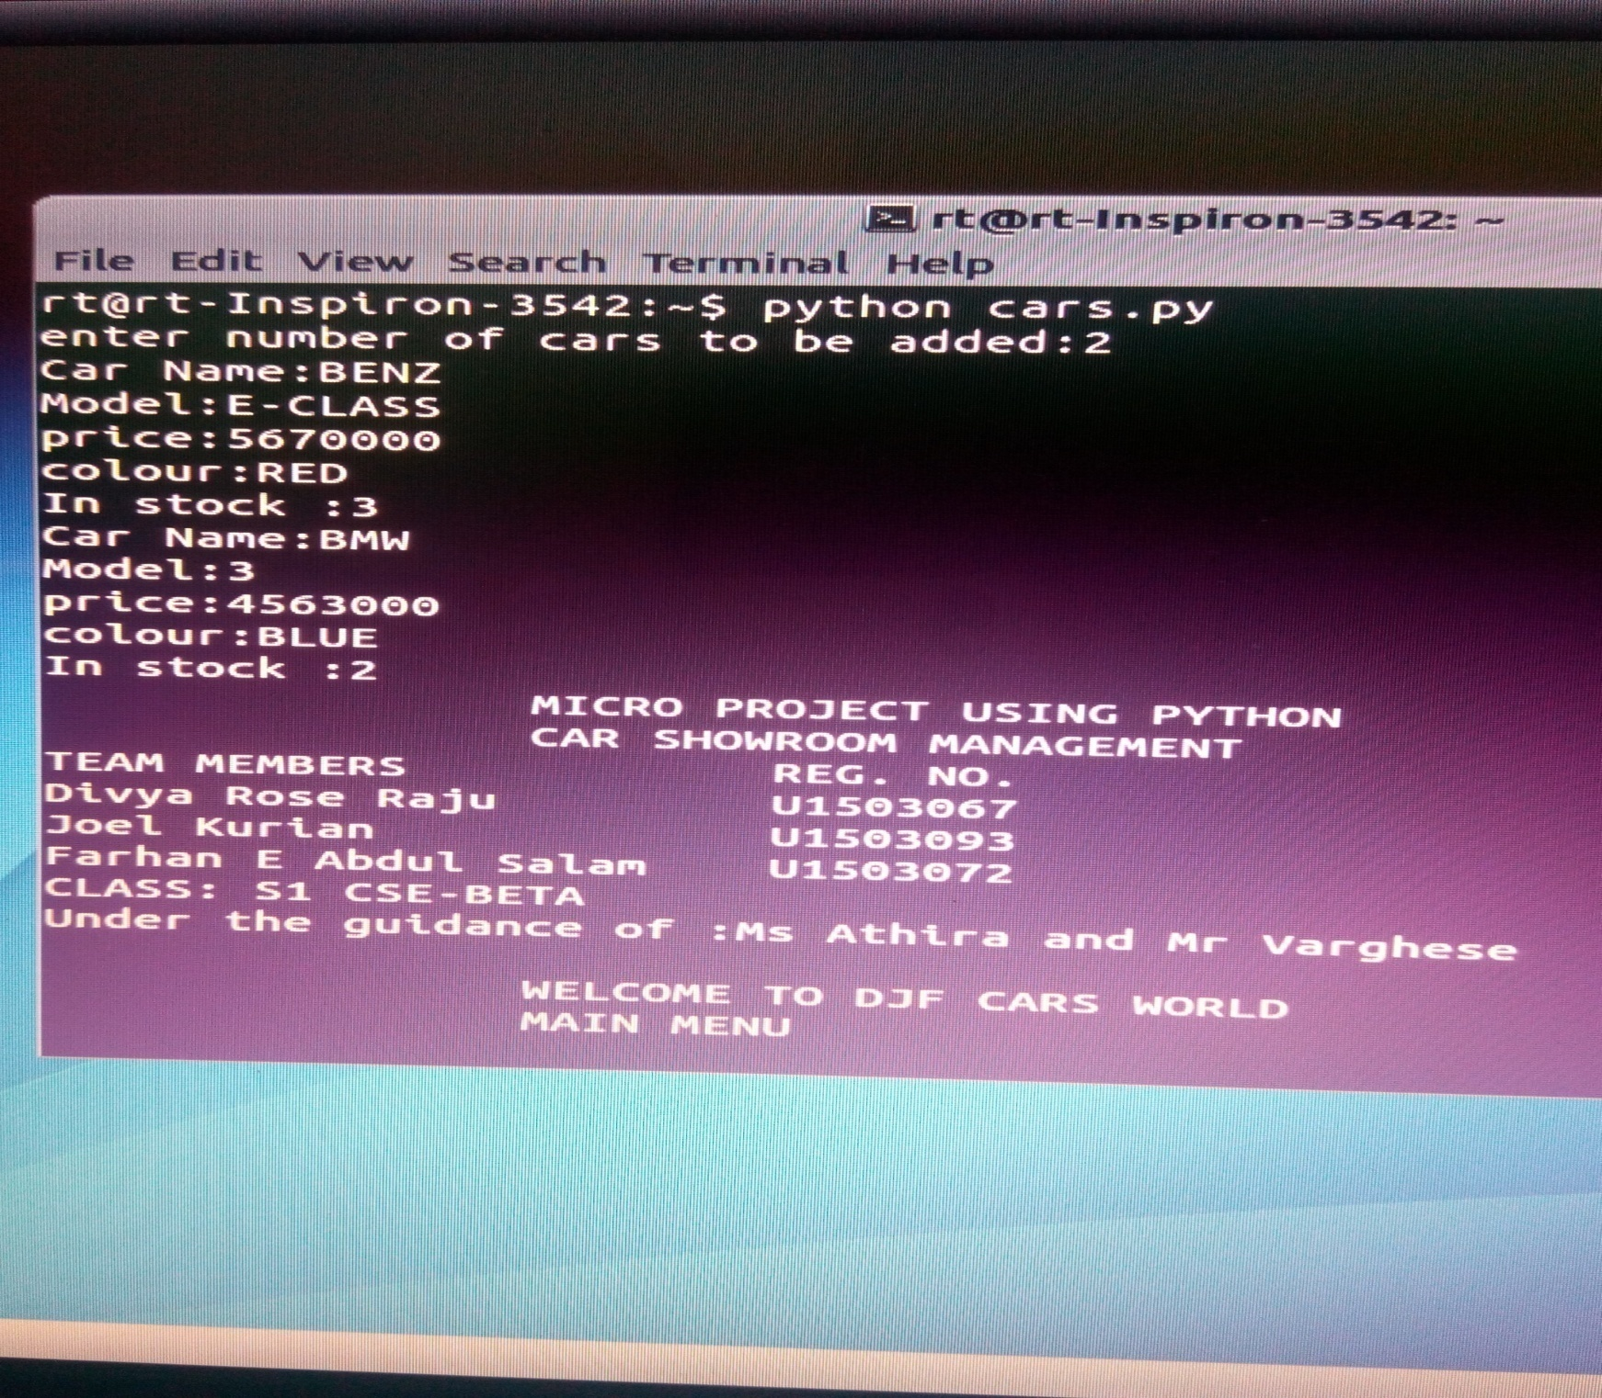

Slide 14
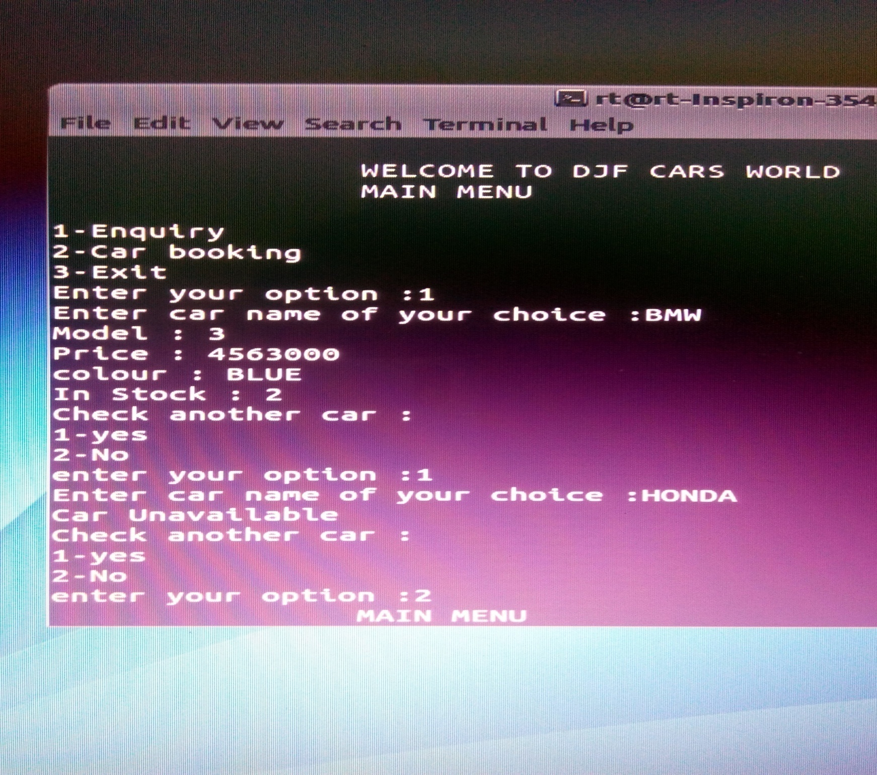

Slide 15
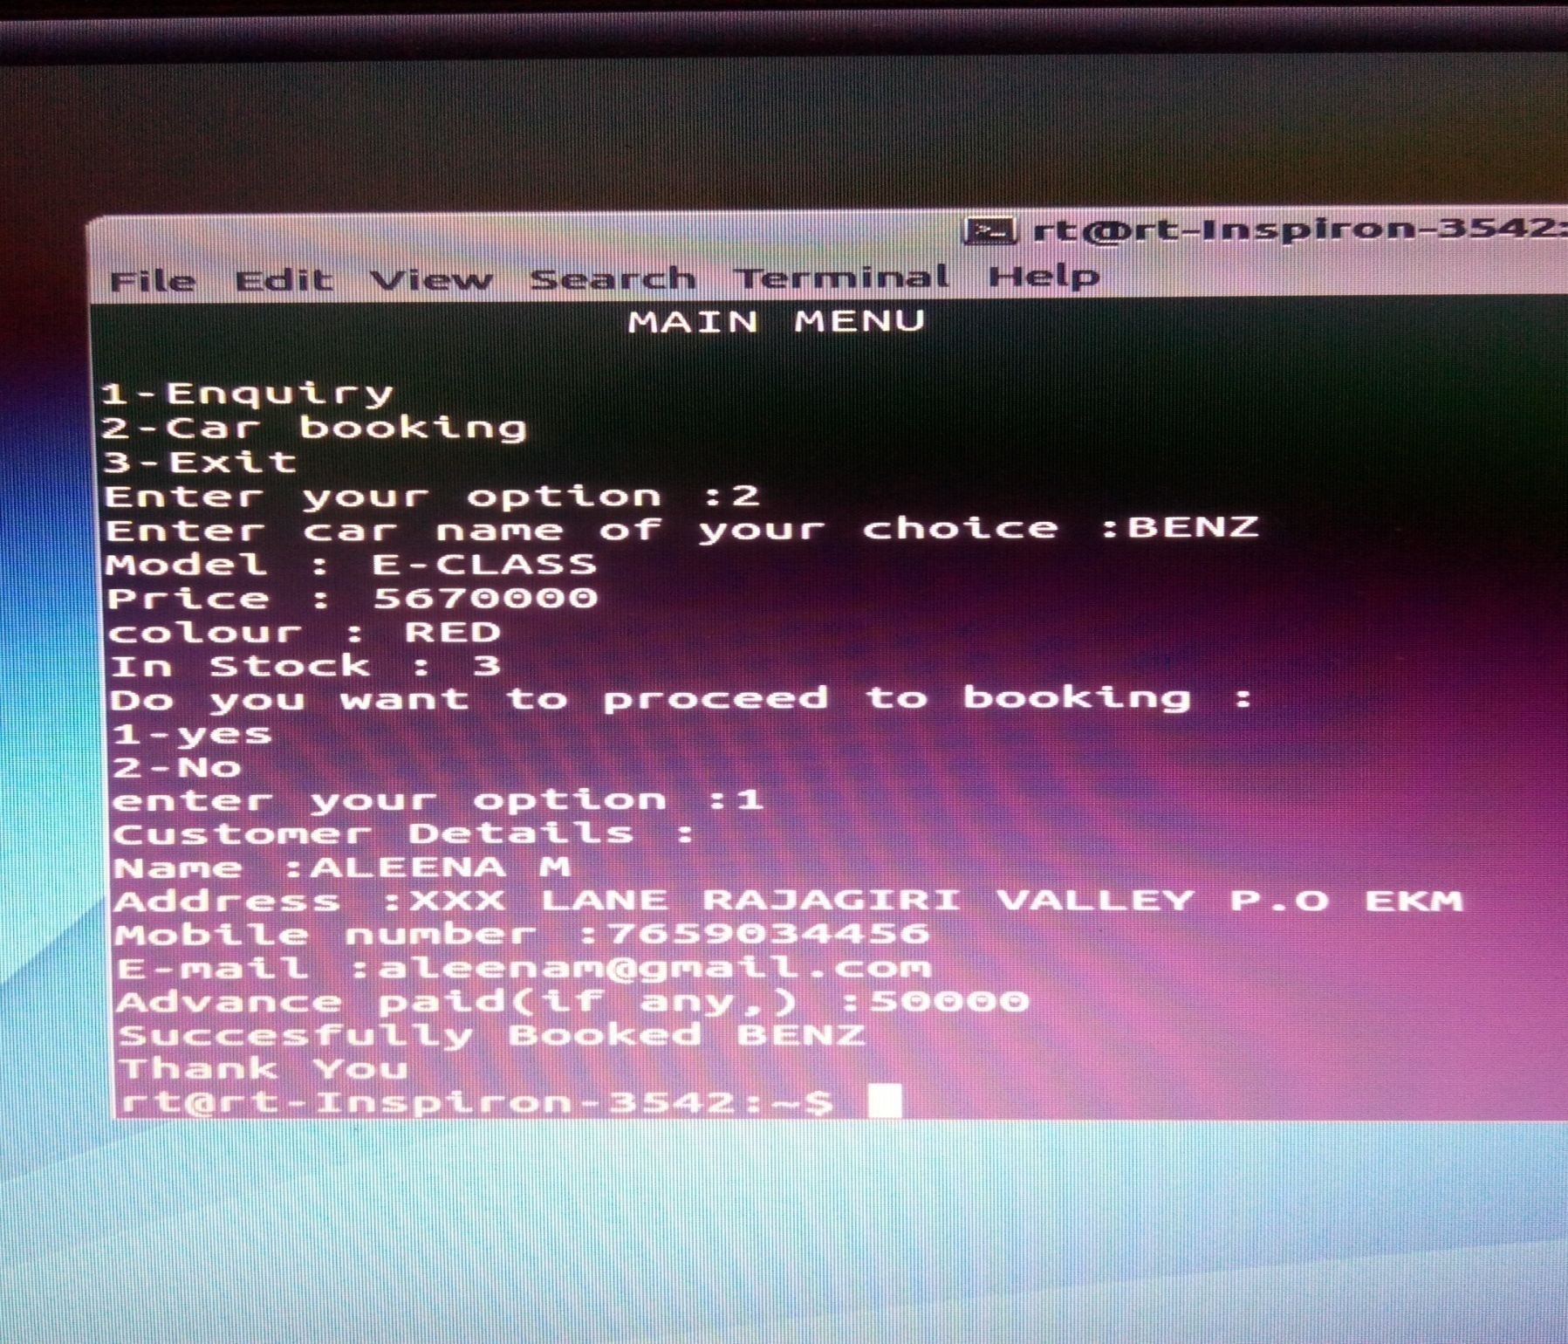

Slide 16
conclusion
The program car showroom management proves to be very useful in the management of a car showroom.It allows the customers to interact with the showroom in a very easy and friendly manner.It beholds the interests and choices of the customers.
Above all,the program has proved to be userfriendly .

